Slide 1
4. Java图形界面编程
Programming with Swing

Slide 2
Java 图形界面编程
Java 1.0：抽象窗口工具包 AWT。
What should have been “write once, run anywhere” turned into “write many times, debug everywhere.”
Java 1.2：Swing 用户界面库。
It was not to use the native controls, but to paint its own.
Java 7-10： JavaFX工具包，包含在JDK中。
Java 11： 不再包含JavaFX。

Slide 3
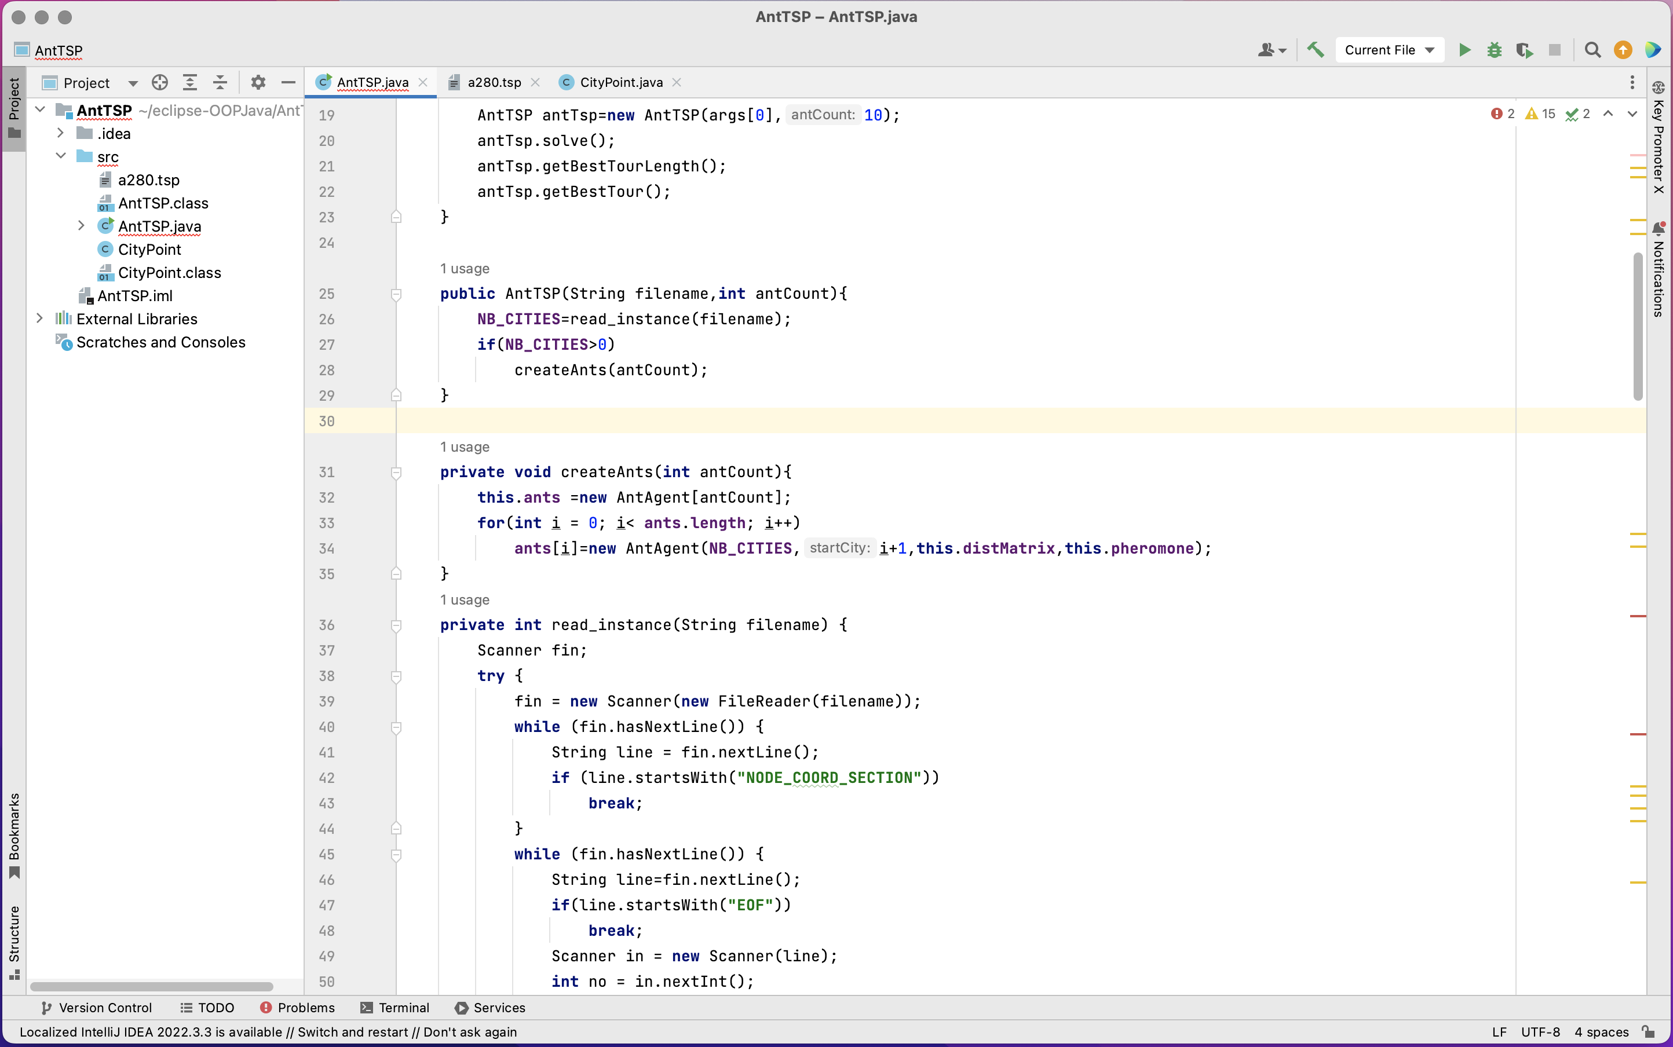
Java Swing
除了慢一点，没有什么缺陷.
学习Swing 可以理解Java GUI编程机制，理解面向对象方法，便于学习其他API.
基于Swing实现的漂亮的Intellij IDEA，可以顺畅的运行在Intel i7 处理器上

Slide 4
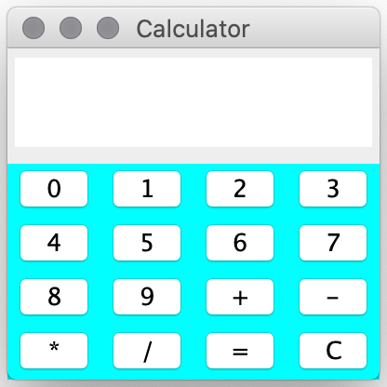
Swing API： javax.swing.*
窗体: 创建主窗体及窗体属性
用户控件：常用的控件，按钮、文本框、..
事件处理: 如何编写响应事件（点击按钮）代码
控件布局: 如何控制控件在窗体上的布局
一切都是对象:
界面是窗体和控件对象的组合；
界面的外观是属性的设置；
事件处理就是对象交互；
计算器
https://docs.oracle.com/javase/tutorial/uiswing/index.html
官方文档

Slide 5
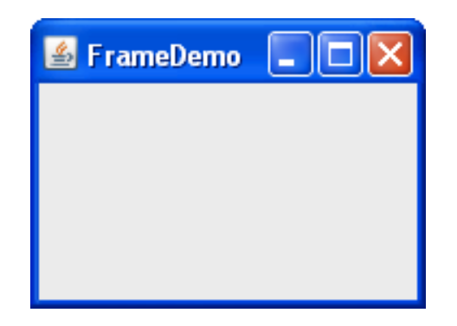
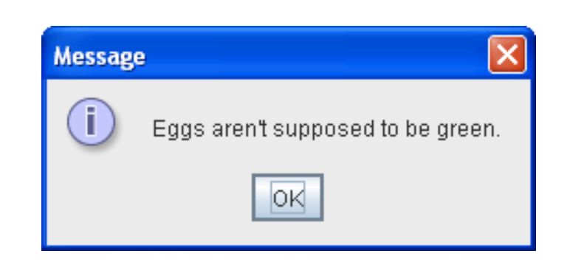
Top-Level Containers(顶层容器)
Swing provides three generally useful top-level container classes: JFrame, JDialog, and JApplet.
JFrame
JDialog
一个Java GUI程序，至少需要一个顶层容器（窗体），它是
GUI程序的root。

Slide 6
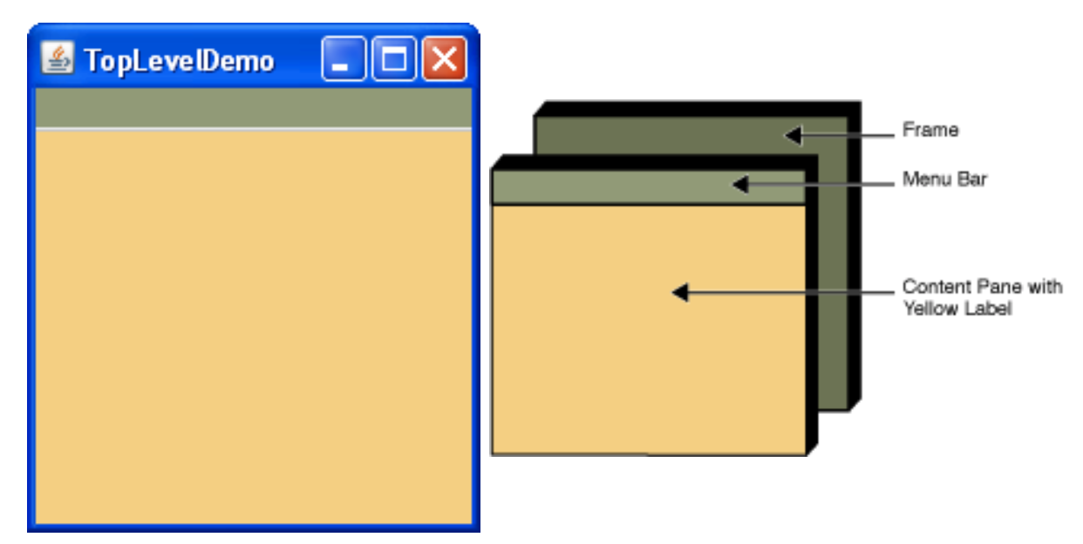
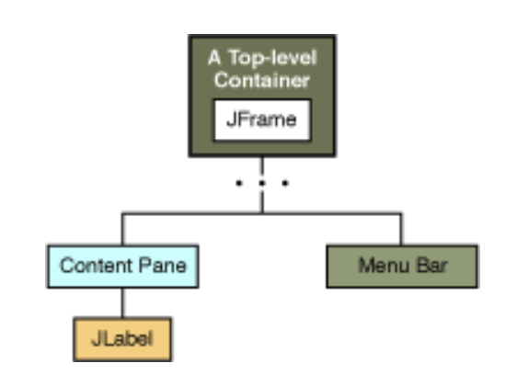
GUI组件构成包含层次 Containment Hierarchy
A containment hierarchy is a tree of components that has a top-level container as its root.
Each top-level container has a content pane that contains (directly or indirectly) the visible components in that top-level container's GUI.

Slide 7
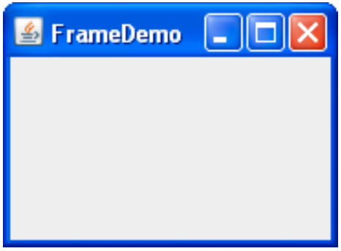
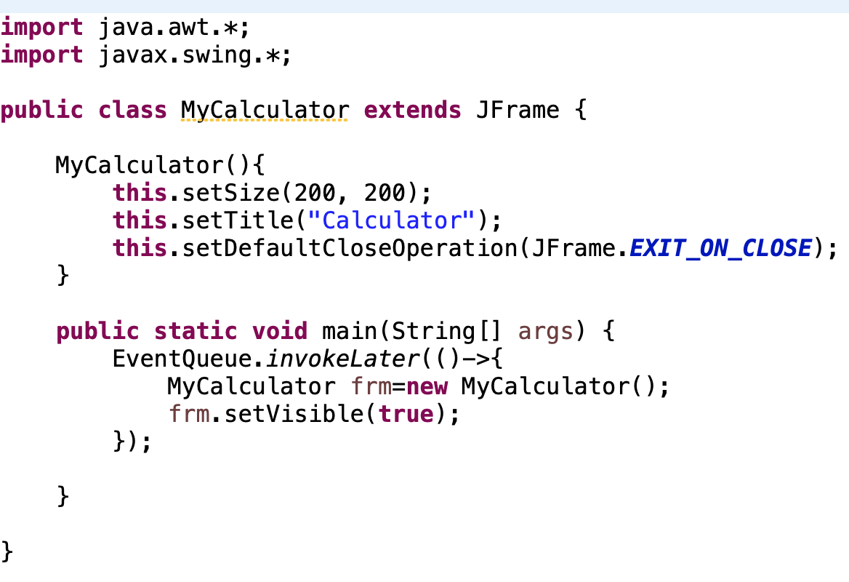
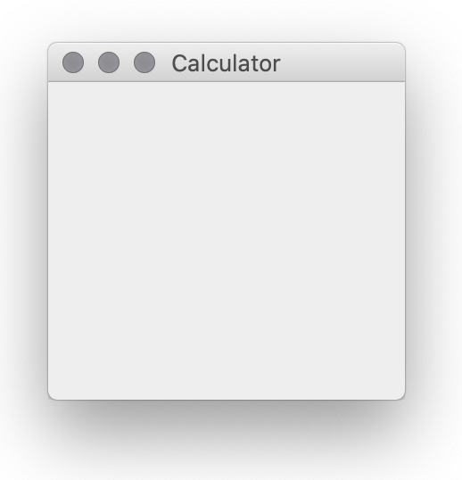
JFrame 顶层窗体
顶层窗体JFrame：第一个启动的窗体，其他控件都放置于该窗体。
导入包
窗体类
Windows
设置窗体属性
创建窗体对象
显示窗体对象
Mac
将窗体对象的创建放在事件分发线程

Slide 8
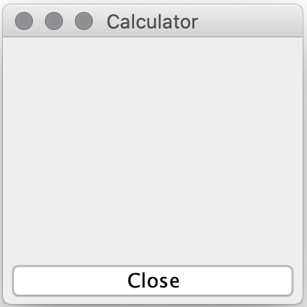
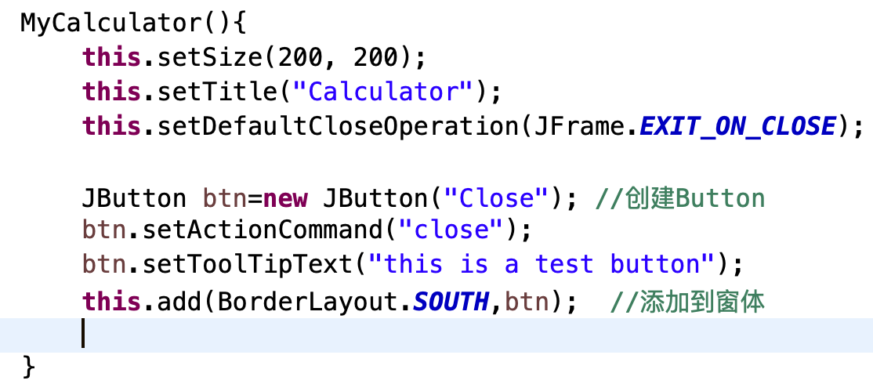
按钮控件 JButton
JButton：javax.swing.JButton
创建一个按钮

Slide 9
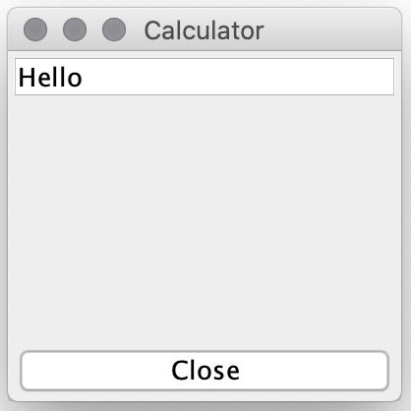
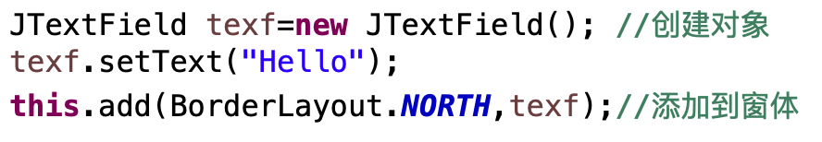
文本框控件 JTextField
javax.swing.JTextField: A text field is a basic text control that enables the user to type a small amount of text.
Methods
String getText()：obtains the text displayed by the text field.
void setColumns(int)：Sets the number of columns displayed by the text field.
void setEditable(boolean): Sets whether the user can edit the text in the text field.

Slide 10
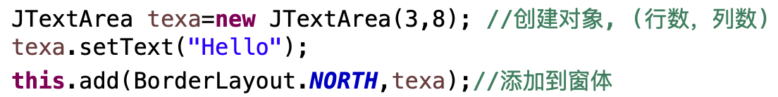
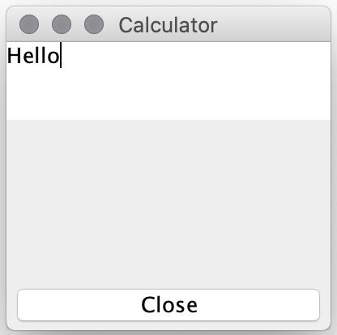
多行文本框控件 JTextArea
javax.swing.JTextArea: The JTextArea class provides a component that displays multiple lines of text and optionally allows the user to edit the text.
Methods
void append(String): Adds the specified text to the end of the text area.
void setText(String): Sets or obtains the text displayed by the text area.

Slide 11
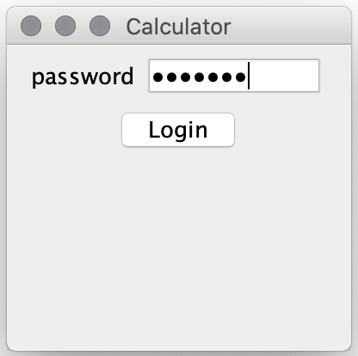
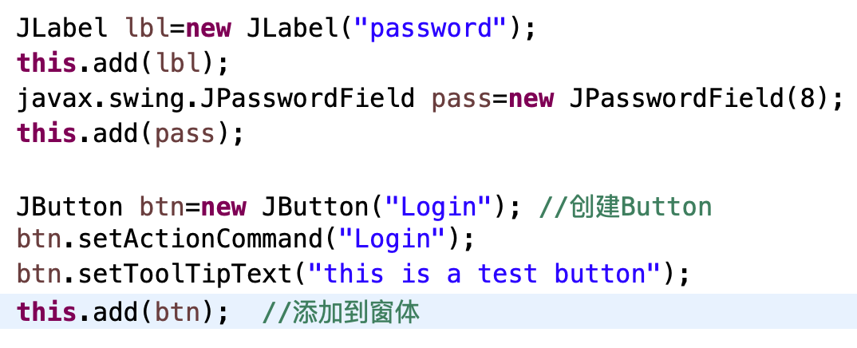
标签 JLabel与密码框
javax.swing.JLabel: With the JLabel class, you can display unselectable text and images.
javax.swing.JPasswordField: The JPasswordField class, a subclass of JTextField, provides specialized text fields for password entry.
JPasswordField Methods
char[] getPassword()：Returns the password as an array of characters.

Slide 12
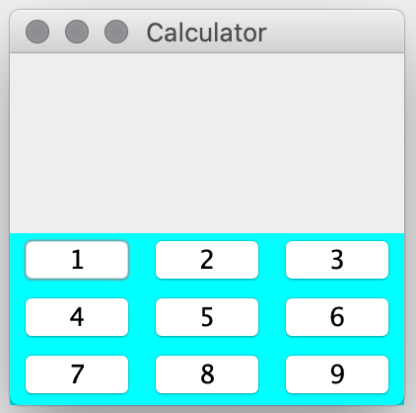
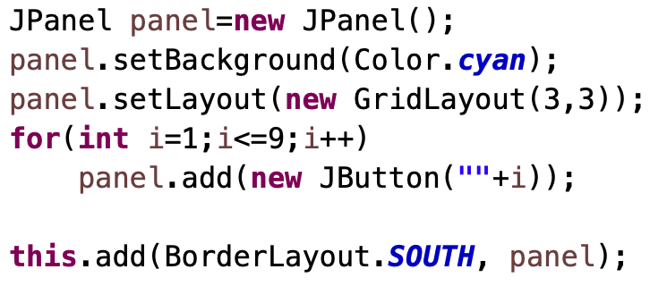
容器控件 Container
JFrame：A frame, implemented as an instance of the JFrame class, is a window that has decorations such as a border, a title, and supports button components that close or iconify the window.
JPanel：JPanel is a generic lightweight container.

Slide 13
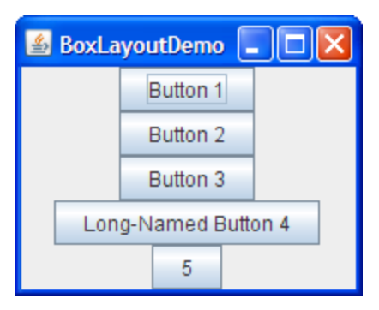
布局控件 Layout Components
Layout：A container uses a layout manager to control how to place it’s components. Each container has a layout manager.
Java layout managers:
BorderLayout:
FlowLayout:
GridLayout:
BoxLayout:
north
west
center
east
south

Slide 14
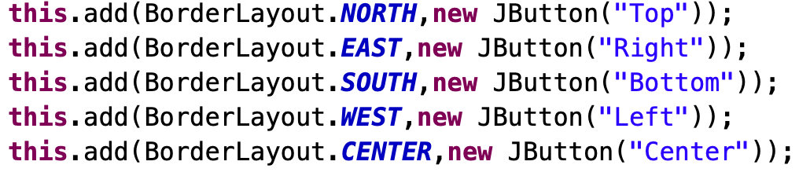
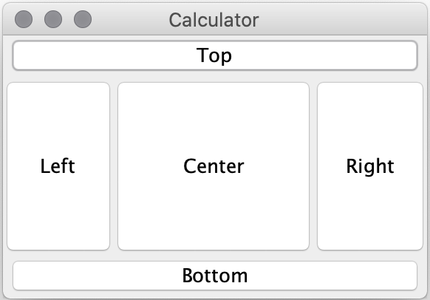
BorderLayout Manager
BorderLayout： A BorderLayout places components in up to five areas: top, bottom, left, right, and center.
north
west
center
east
south

Slide 15
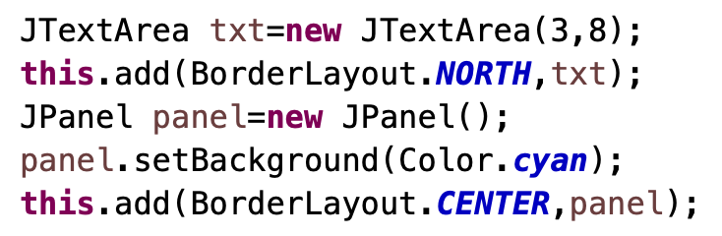
BorderLayout Manager
Implement Layout for Calculator.
JTextArea
JPanel
Layout with BorderLayout
north
north
west
center
center
south

Slide 16
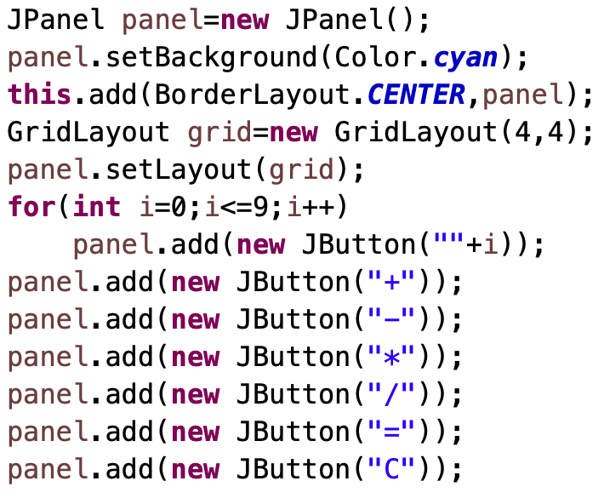
GridLayout Manager
A GridLayout object places components in a grid of cells. Each component takes all the available space within its cell, and each cell is exactly the same size.

Slide 17
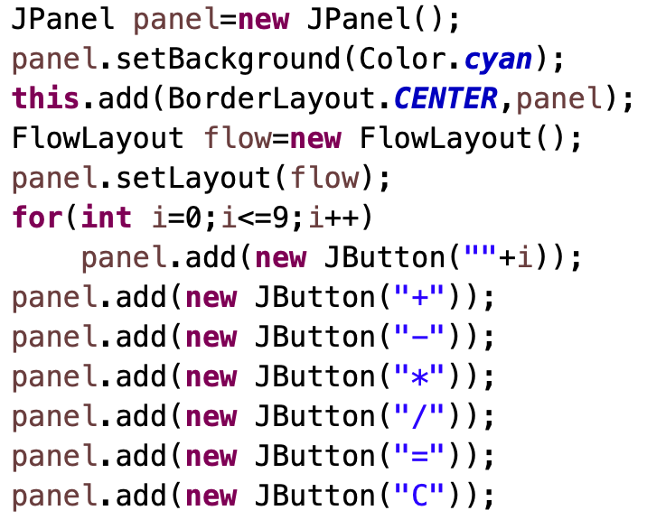
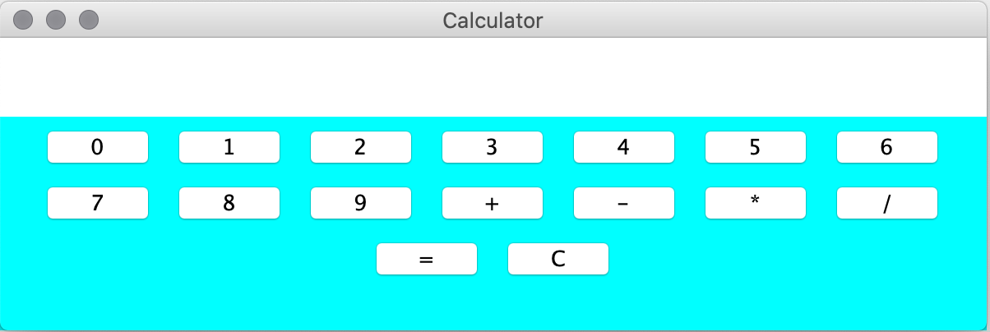
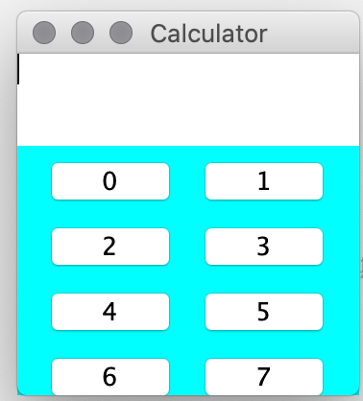
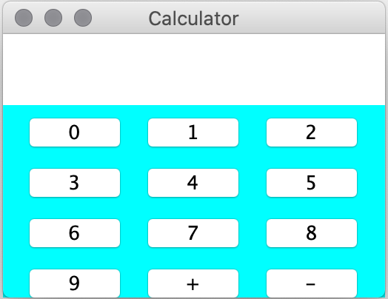
FlowLayout Manager
The FlowLayout class puts components in a row, sized at their preferred size. If the horizontal space in the container is too small to put all the components in one row, the FlowLayout class uses multiple rows

Slide 18
事件处理 Event Handling
用户在GUI程序中，通过键盘输入和鼠标点击与程序进行交互。
用户的一个交互动作，称为一个事件（event），比如：点击一个按钮。
能够引发事件的控件，称为事件源，比如一个按钮，一个菜单；
每个事件源提供了方法来注册事件监听器，对事件作出响应；
事件监听器是一个实现了监听器接口的对象；
当一个事件发生时，事件源将事件对象发送给事件监听器。
Event Interface
Event Source
事件对象
Event Listener
注册

Slide 19
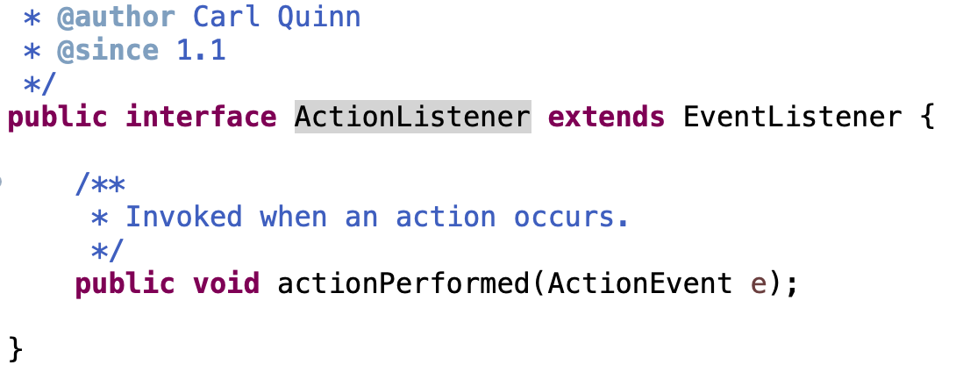
按钮事件监听器
用户点击数字0-9，’+’,’-’,’*’,’/’ 文本框显示按钮对应的字符
用户点击‘=’时，计算已输入的计算式的值
用户点击‘C’时，清除已输入的公式
JButton 动作事件监听器 ActionListener
public void addActionListener(ActionListener l)
函数式接口

Slide 20
ActionListener事件监听器
The listener interface for receiving action events. The class that is interested in processing an action event implements this interface, and the object created with that class is registered with a component, using the component's addActionListener method.
When the action event occurs, that object's actionPerformed method is invoked.

Slide 21
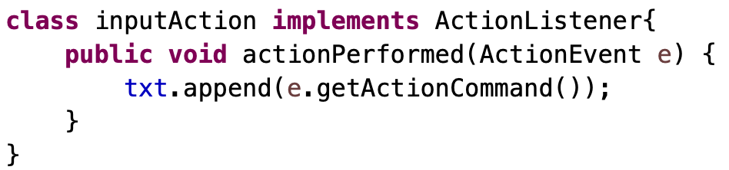
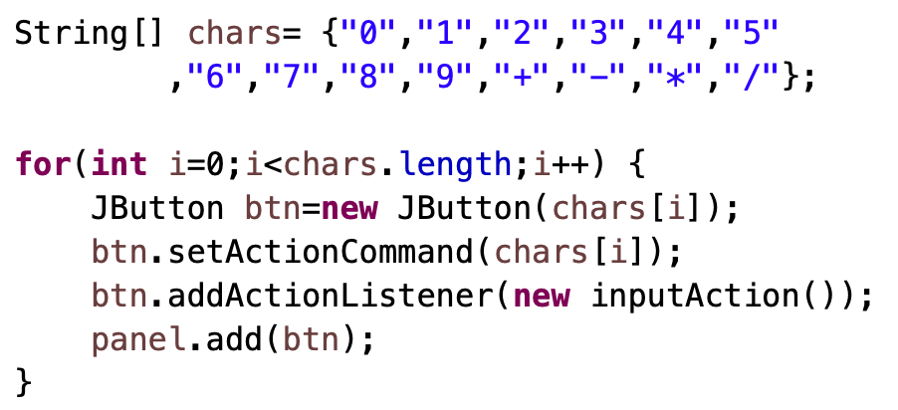
Calculator 事件监听器
数字0-9，’+’,’-’,’*’,’/’ 文本框显示按钮对应的字符
实现监听器类
注册监听器对象

Slide 22
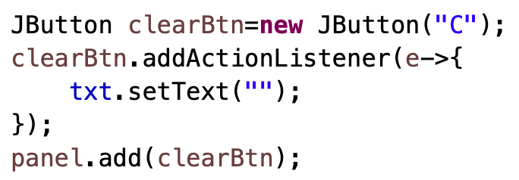
Calculator 事件监听器
为C（Clear） 按钮实现监听器：点击时，清除已输入的内容。
用lambda 表达式注册监听器
class clearAction implements ActionLister{
public void actionPerformed(ActionEvent e){
txt.setText(“”);
}
}
如果定义类，这个类是内部类吗？

Slide 23
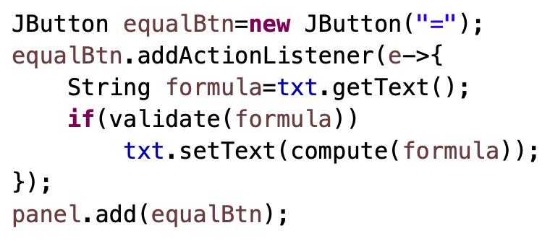
Calculator 事件监听器
为 = 按钮实现监听器：点击时，计算输入的表达式的值。

Slide 24
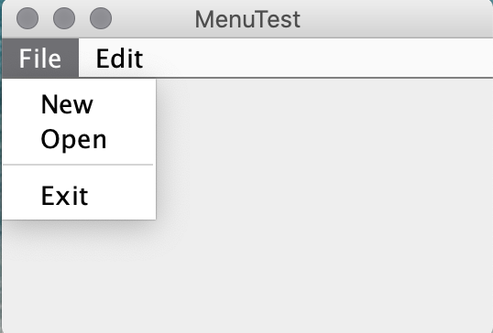
JMenus 菜单
A menu provides a space-saving way to let the user choose one of several options
结构：
菜单栏：JMenuBar
菜 单：JMenu
菜单项：JMenuItem
JMenuBar
JMenu
JMenu
JMenu
JMenuItem
JMenuItem

Slide 25
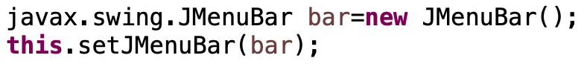
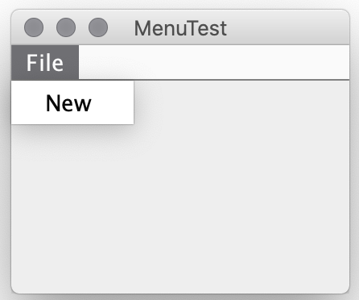
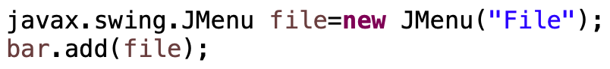
配置 菜单
为窗体添加菜单栏
为菜单栏添加菜单
为菜单添加菜单项

Slide 26
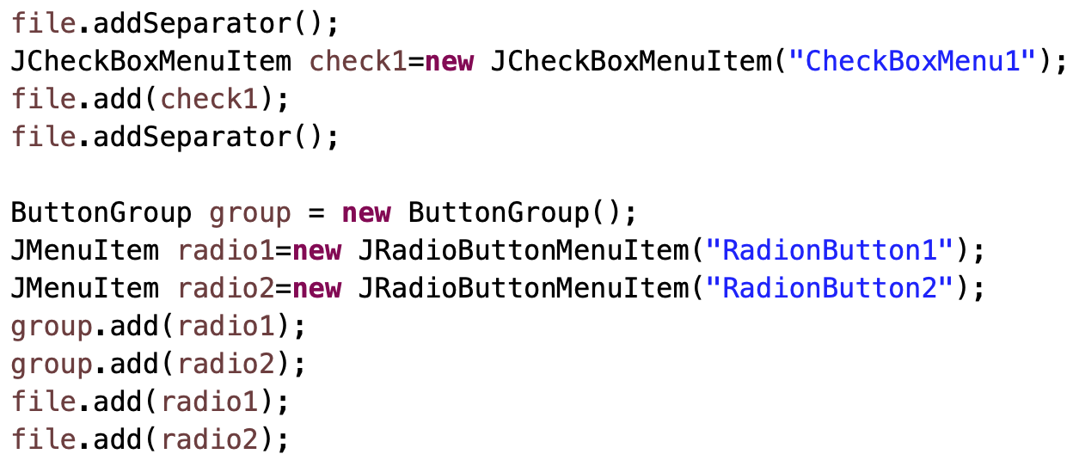
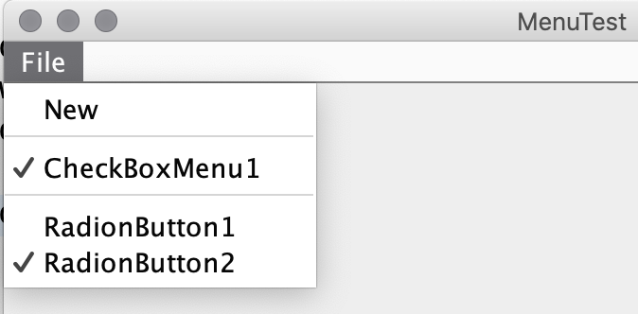
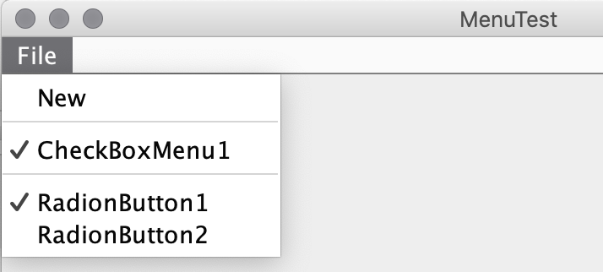
CheckBox RadioButton 菜单
仅有一个可以勾选

Slide 27
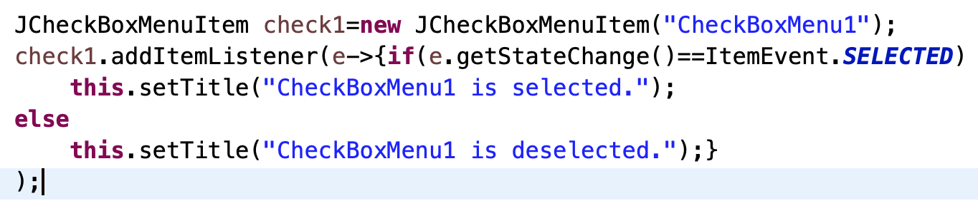
菜单事件 Handling Events from Menu Items
To detect when the user chooses a JMenuItem, you can listen for action events (just as you would for a JButton).
To detect when the user chooses a JRadioButtonMenuItem, you can listen for either action events or item events, as described in How to Use Radio Buttons.
For JCheckBoxMenuItems, you generally listen for item events, as described in How to Use Check Boxes.

Slide 28
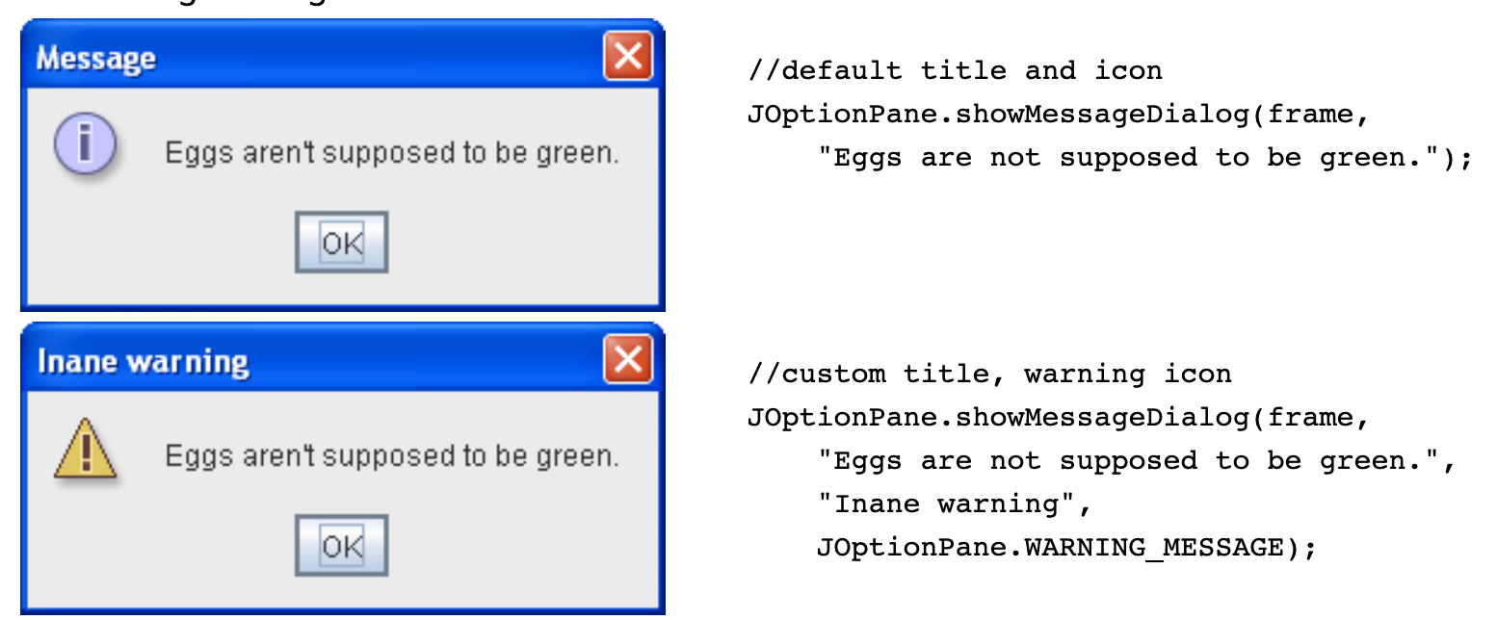
对话框 Dialogs (https://docs.oracle.com/javase/tutorial/uiswing/components/dialog.html)
A Dialog window is an independent sub window meant to carry temporary notice apart from the main Swing Application Window.
Most Dialogs present an error message or warning to a user.
For convenience, several Swing component classes can directly instantiate and display dialogs. e.g., JOptionPane class.

Slide 29
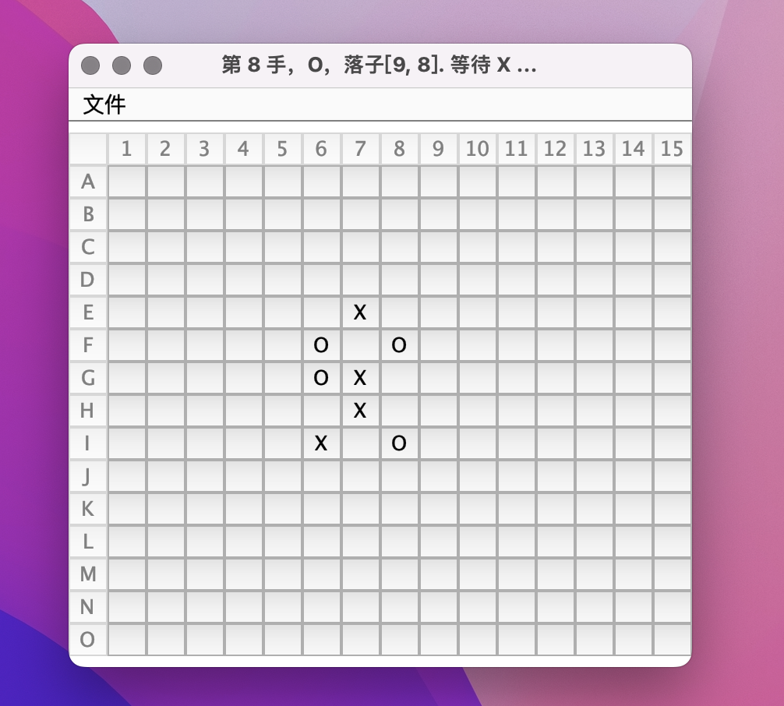
Homework
做一个五子棋小程序
棋盘15x15
自动判断输赢
当一方获胜后，提示获胜方，并标识出获胜的棋子
可以悔棋

Slide 30
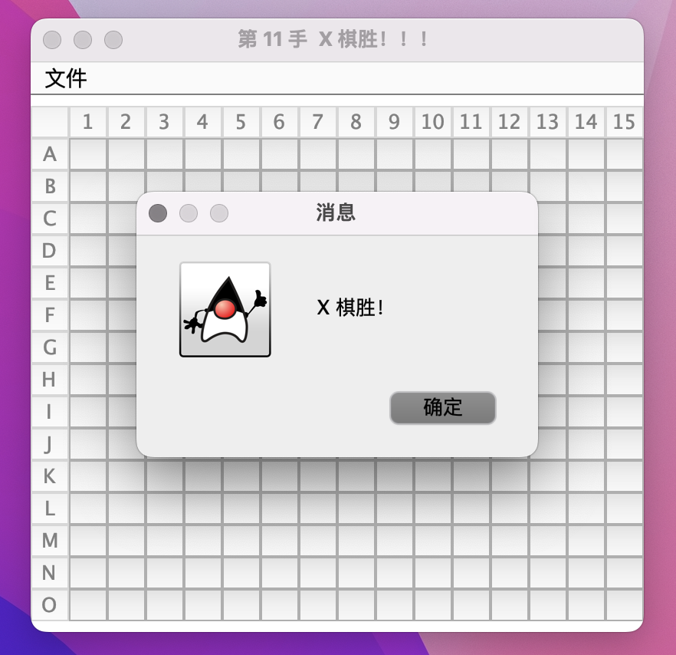
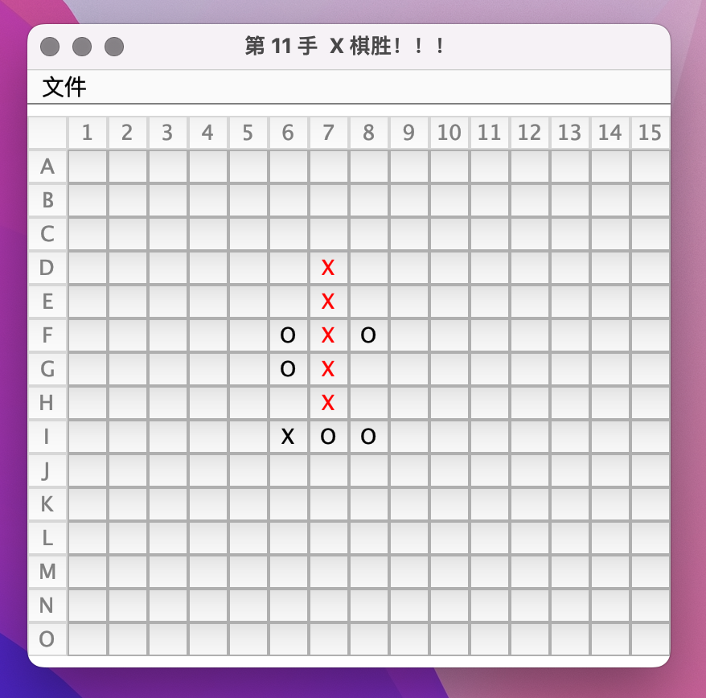
Homework
自动判断输赢
标识获取的棋子

Slide 31
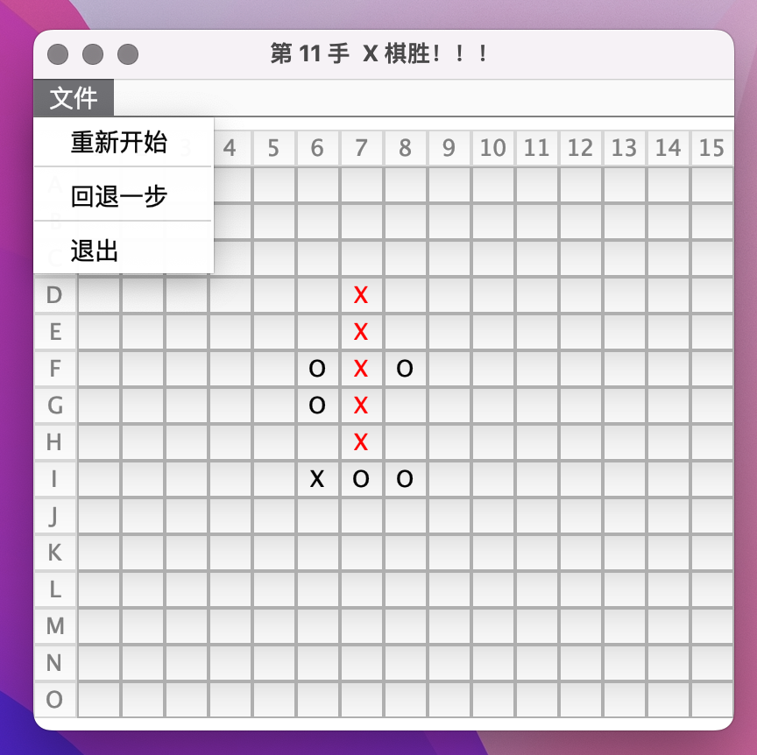
Homework
 |  |  |  |  |  |  | X
 |  |  |  |  |  |  | X
 |  |  |  |  |  | O | X | O
 |  |  |  |  |  | O | X
 |  |  |  |  |  |  | X
 |  |  |  |  |  | X | O | O
通知
更新
模型 model
负责下棋的逻辑
视图 view
负责与用户交互

